Slide 1
Sudoku Generator and Solver Project
MR. DB

Slide 2
A.) Generation of Valid Sudoku
https://www.geeksforgeeks.org/program-sudoku-generator/

Slide 3
How to Generate Sudoku?
Fast Method [2/3 Methods]
Check if Given Sudoku is Valid or Not?
stackoverflow
https://www.geeksforgeeks.org/check-if-given-sudoku-solution-is-valid-or-not/
https://www.101computing.net/sudoku-generator-algorithm/

Slide 4
B.) Solving the Sudoku Algorithm
https://www.geeksforgeeks.org/solving-sudoku-using-bitwise-algorithm/

Slide 5
c.) UI Integration
No Black and Green Sudoku
https://www.geeksforgeeks.org/building-and-visualizing-sudoku-game-using-pygame/

Slide 6
D.) Make it Real Life
Scan and Solve

Slide 7
E.) 4X4, 9x9, 16x16, ...
NXN?

Slide 8
F.) Mathematics Behind Sudoku
Automorphic Sudokus?

Slide 9
Minimum Clues to Solve Sudoku?
Add your first bullet point here
Add your second bullet point here
https://www.technologyreview.com/2012/01/06/188520/mathematicians-solve-minimum-sudoku-problem/

Slide 10
G.) Dancing Links?

Slide 11
H.) Types of Sudoku?
Variations? Jigsaw/Windoku..

Slide 12
I.) Graphs?
A Sudoku puzzle can be expressed as a graph coloring problem

Slide 13
J.) Visual Animation of Backtracking?
How it solves Step by Step Animation?

Slide 14
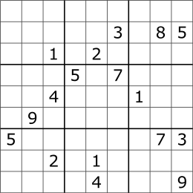
A Sudoku designed to work against the brute force algorithm

Slide 15
SUDOKU SOLVER ALGORITHM
NAÏVE ALGO
BACKTRACKING
https://www.geeksforgeeks.org/sudoku-backtracking-7/

Slide 16
UI to Game

Slide 17
Suggests?

Slide 18
Suggests?

Slide 19
Suggests?

Slide 20
Suggests?

Slide 21
Add a Slide Title - 1

Slide 22
Title and Content Layout with List
Add your first bullet point here
Add your second bullet point here
Add your third bullet point here

